Slide 1
Probabilistic Binary Activation Layers in Neural Networks
Blake Keeling

Slide 2
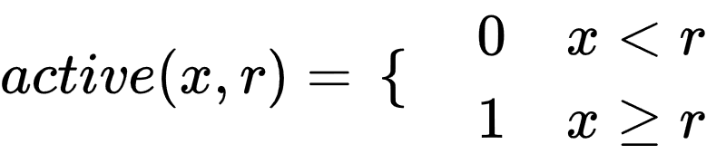
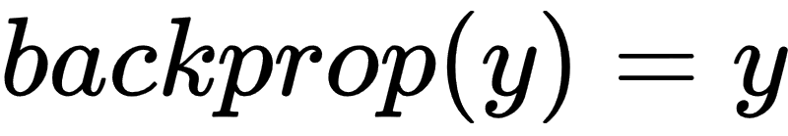
Probabilistic Binary Activation Function
where x is the value given to the node and r is a random value from a uniform distribution. x is assumed to be a value (0,1). y is the error from the following layer.

Slide 3
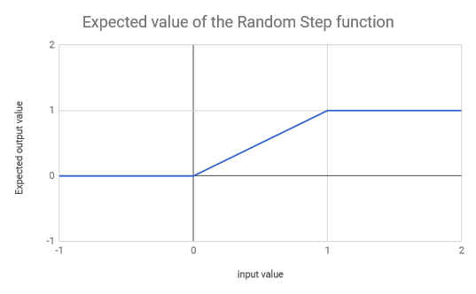
Random Step Layer

Slide 4
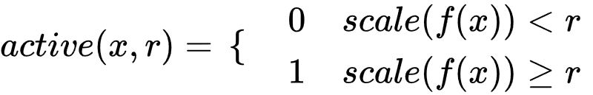
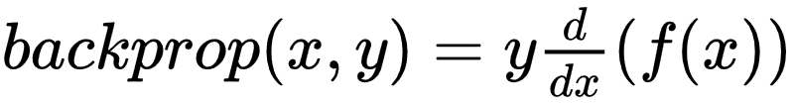
Simplified binary activation layer
where f(x) is an activation function with finite minimum and maximum outputs. scale is a function that scales the output of f(x) such that the values range is (0,1)

Slide 5
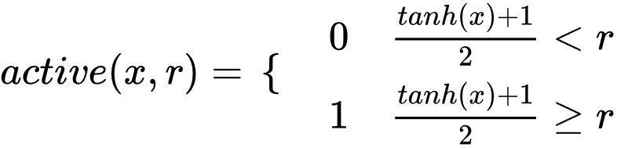
Example implementation using TanH

Slide 6

Mux layer
A layer intended to be used after a binary activation layer. It functions similarly to a standard linear layer.

Slide 7
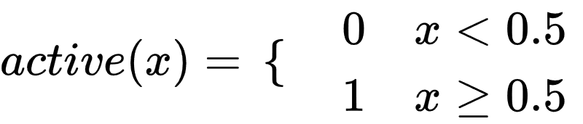
Fixed Evaluation
The random value in the random step layer allows for back propagation by taking advantage of the expected value equation. However when not training the neural net it is beneficial to instead use the average value of r (0.5).

Slide 8
Neural Net architecture
Experimental
Baseline
788
788
Linear Layer
Linear Layer
200
200
Random Step (Tanh) Layer
Tanh Layer
200
200
Mux Layer
Linear Layer
100
100
Random Step (Tanh) Layer
Tanh Layer
100
100
Linear Layer
Linear Layer
10
10

Slide 9
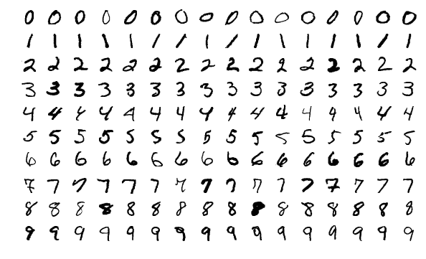
MNIST Dataset
By Josef Steppan - Own work, CC BY-SA 4.0, https://commons.wikimedia.org/w/index.php?curid=64810040

Slide 10
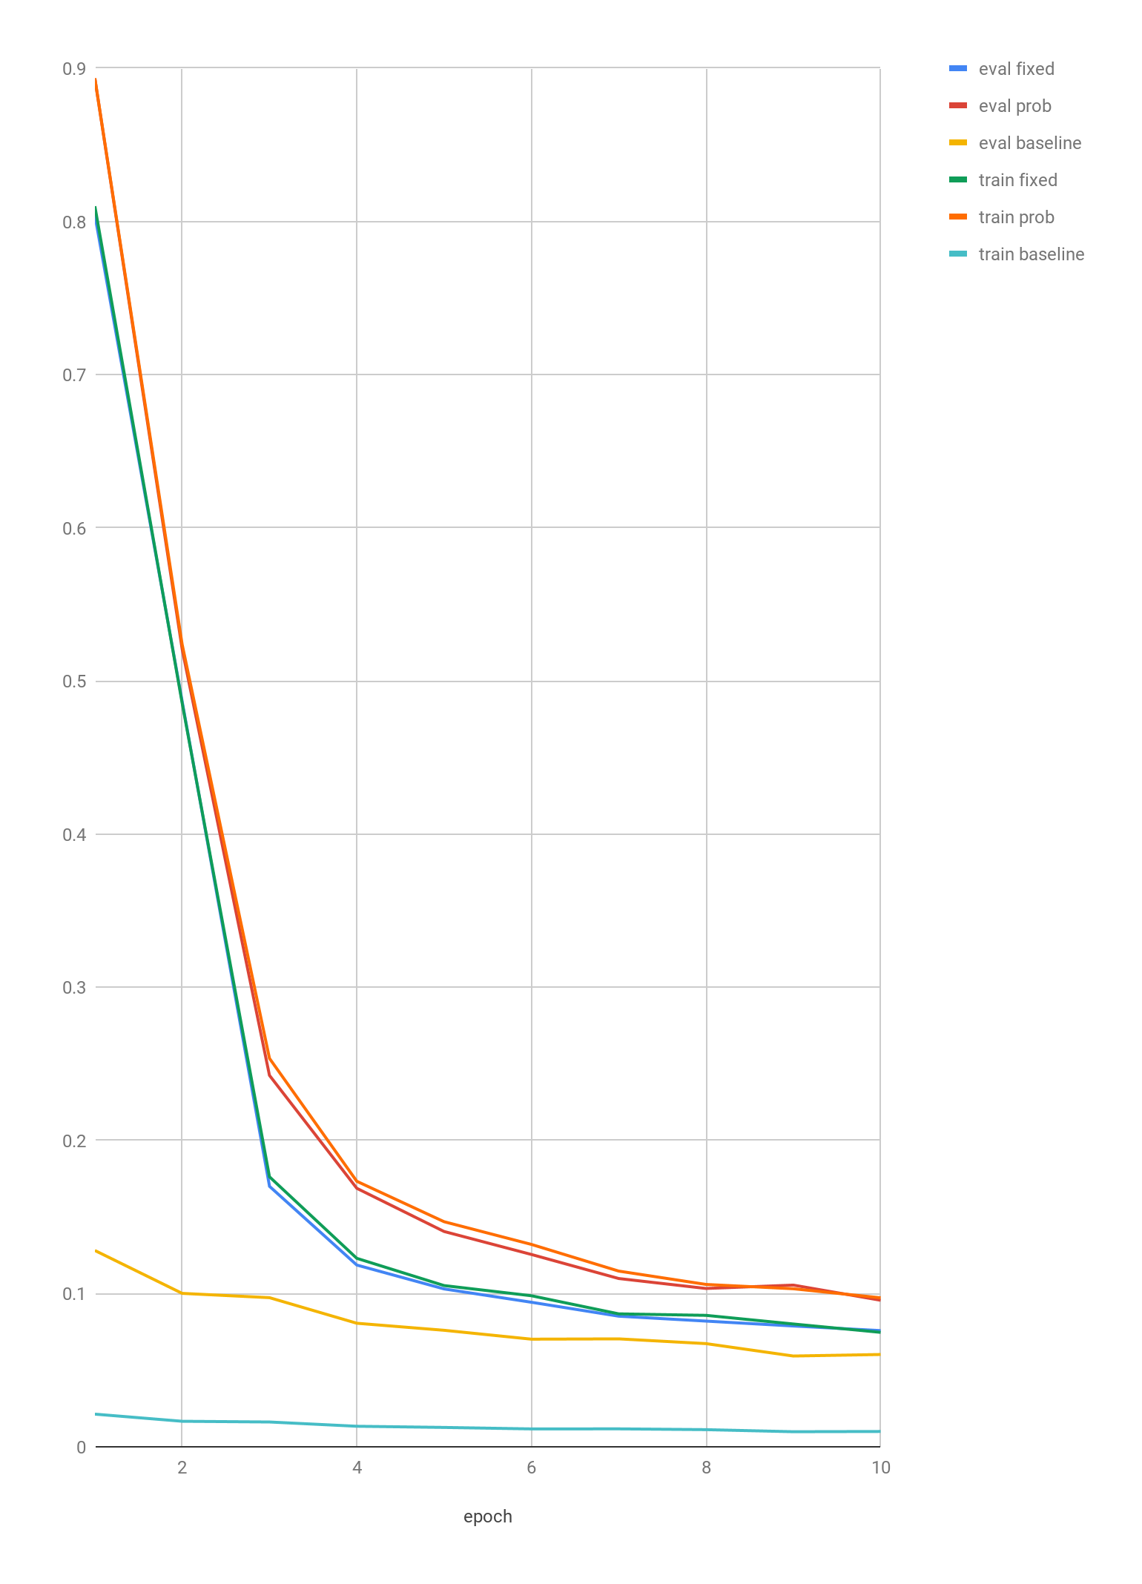
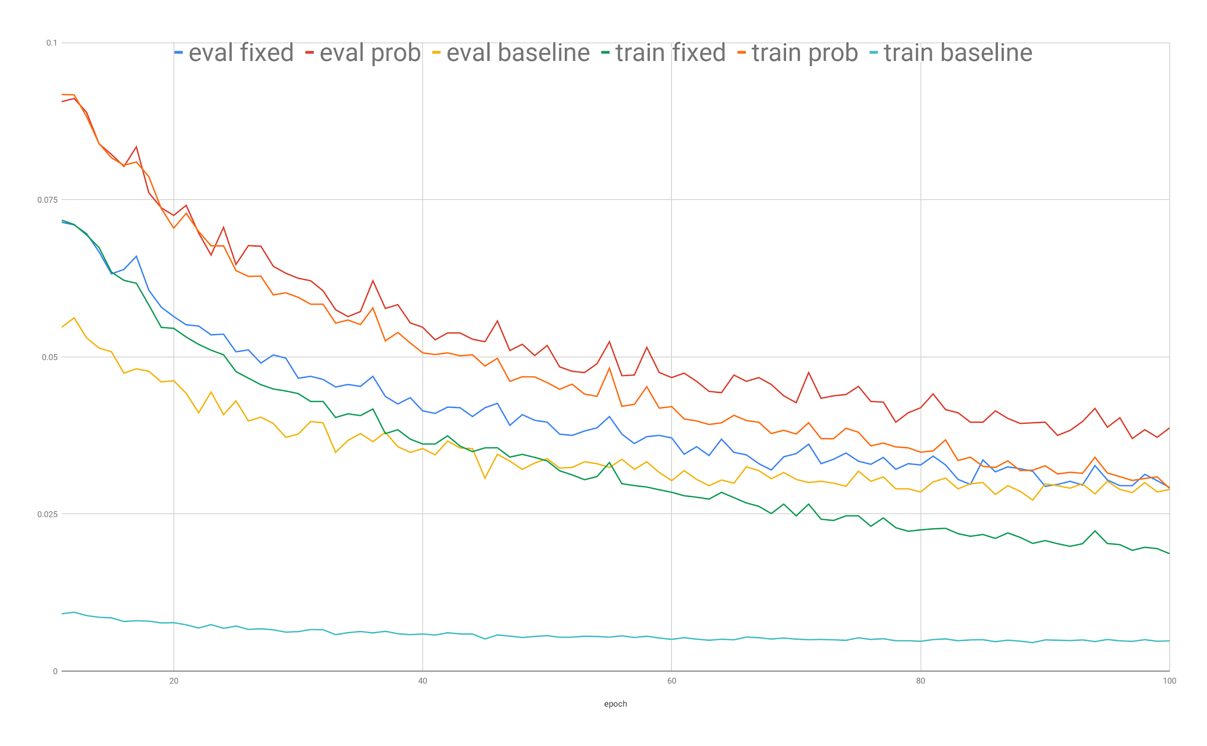

Slide 11
Future Work
Applying this concept to Convolutional layers
Applying information theory techniques to encourage mirror neurons
Designing a formula to convert the fixed evaluation process to logic gates to optimize a physical implementation (FPGA) after training is complete
Implementation using GPU ready libraries
Auto-Topological Neural Networks (Hopefully)

